Slide 1
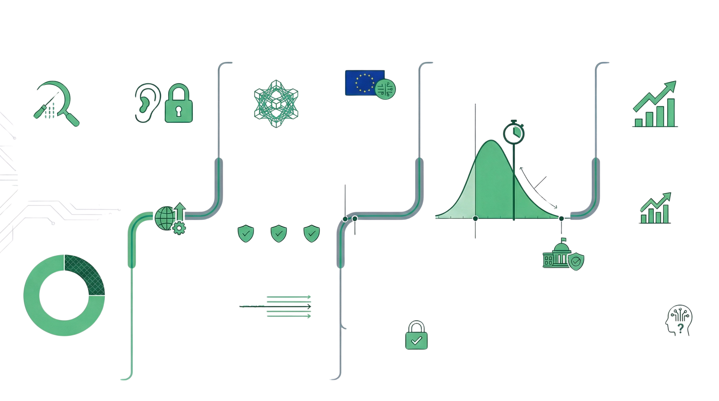
The Quantum Countdown: Understanding HNDL, PQC, and the Road to Q-Day
IMMEDIATE RISK:
WHAT IS HNDL?
2
THE SOLUTION:
WHAT IS PQC?
TIMELINE TO Q-DAY
Q-Day: The Cryptographic Collapse
Prediction markets estimate a 40% probability
that a quantum computer capable of cracking
2048-bit RSA will exist by this year.
ECONOMIC &
INDUSTRY IMPACT
Q2 2026:
The European
Quantum Act
The European
Commission is
scheduled to propose a
legislative framework
to foster a resilient,
sovereign quantum
ecosystem in the EU.
Q-DAY
Harvest Now,
Decrypt Later (HNDL)
A surveillance strategy where
attackers intercept and archive
encrypted traffic today to
decrypt it in the future once
powerful quantum computers
become available.
The "Silent" Threat
to Long-Term Data
HNDL specifically targets data
with long confidentiality
lifetimes, such as personal
health records (PHI), diplomatic
communications, and
intellectual property.
Post-Quantum
Cryptography (PQC)
Also known as quantum-resistent
cryptography, these are algorithms
(primarily lattice-based or
hash-based) designed to resist
attacks from both classical and
quantum computers.
The Three Primary
NIST Standards
$12.4 Billion
Market Value
The PQC market is projected
to grow from $1.9 billion in
2025 to over $12.4 billion by
2035 at a 20.9% CAGR.
Significant
probability on its
arrival between
2034 and 2044
$500-$600 Billion
in Bitcoin at Risk
2030s
34% Improvement in
Algorithmic Trading
HSBC and IBM demonstrated
that quantum-classical
hybrid systems could
significantly outperform
classical-only methods in
predicting bond trade till
probabilities.
2024-2025:
Transition Begins
NIST releases first
three PQC standards;
NSA releases CNSA
2.0; and the US
issues executive
orders for federal
PQC adoption.
FIPS 203 FIPS 204 FIPS 205
(ML-KEM) (ML-DSA) (SLH-DSA)
Q2 2026:
The European
Quantum Act
The European Commission
is scheduled to propose
a legislative framework
to foster a resilient,
sovereign quantum
ecosystem in the EU.
2030: The "Useful"
Quantum Milestone
Prediction markets
estimate a 40% probability
that a quantum computer
capable of cracking
2046-bit RSA will exist by
this year.
Finalized in August 2024, these
are the core standards.
2035:
25%
Quantum-
Exposed
The "No Later
Than" Horizon
The NSA's ultimate
goal for all US
national security
systems to be fully
quantum-resistant,
aligning with the
White House's
NSM-10 directive.
Photonic
signal
2027:
Mandatory
Compliance
All new acquisitions for US
National Security Systems
(NSS) must be CNSA
2.0-compliant by default.
The Global
Talent Gap
Beyond Algorithms:
Physical Layer Security
Methods like photonic shielding
and optical layer encryption can
"hide" the signal in noise,
preventing the "harvest" phase of
an HNDL attack entirely.
Approximately 25% of all Bitcoins are
"quantum-exposed" because their
public kays are already visible on the
blockchain, making them vulnerable
to HNDL-style signature theft.
A projected shortage of
250,000 quantum
professionals by 2030 poses
a significant strategic risk to
the implementation of these
security measures.

